Slide 1
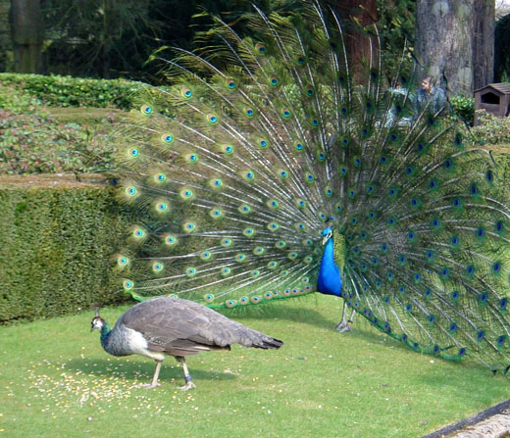
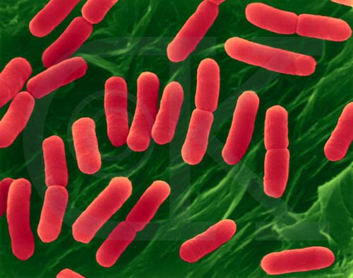
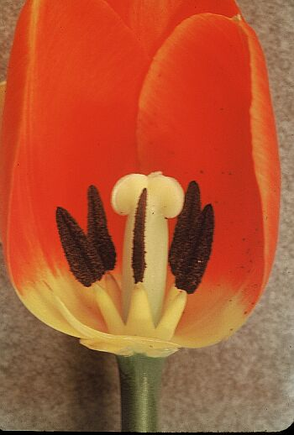
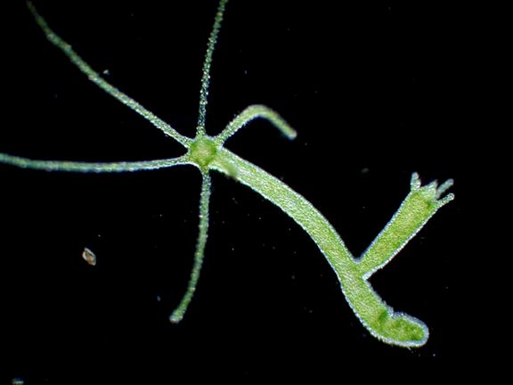
Cell Reproduction

Slide 2
Video

Slide 3
Why do cells reproduce?
Organisms make new cells instead of having their cells grow larger. The reason for this is there isn’t enough ____________________ in the cell membrane to meet the needs of the ____________________ (or total space) inside the cell. Cells will divide into two cells (reproduce) before they become too large to function properly.
_________________________________ – If you get a cut or break a bone, cells will divide to help heal the area.
SURFACE AREA
VOLUME
1 cm
1 cm
3 cm
1 cm
3 cm
3 cm
INJURY REPAIR

Slide 4
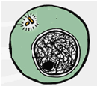
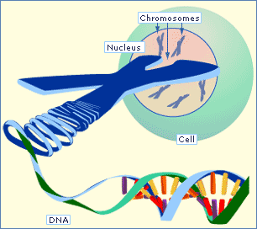
Terms to Know
Term | Definition | Picture
 | DNA that is loose and uncoiled when a cell is not dividing.
 | Tightly coiled DNA that forms during mitosis. DNA is copied before it coils up into a chromosome
 | Each half of a copied chromosome. One half of the X is ________________ to the other half since it is a copy of the DNA. | X
 | Where each half the X is held together.
CHROMATIN
CHROMOSOME
SISTER CHROMATID
IDENTICAL
SISTER CHROMATIDS
CENTROMERE
CENTROMERE

Slide 5
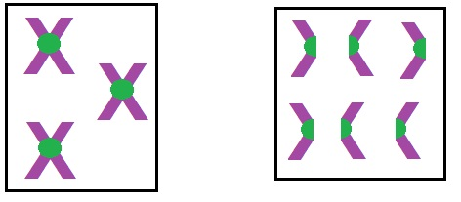
How do you count chromosomes?
When asked the particular number of chromosomes in a cell, always count ________________!!!!!
Why does the DNA coil up into chromosomes before cell division?
CENTROMERES
3 chromosomes and 6 sister chromatids
6 chromosomes
SO THE DNA CAN MOVE AROUND THE CELL DURING MITOSIS.

Slide 6
Control of the Cell Cycle
Cell cycle has key checkpoints to trigger or delay the next phase. The goal of the checkpoints is to make sure the cell is healthy, strong and completing each step correctly. DNA controls these checkpoints. A mutation in the DNA that controls the cell cycle leads to ______________.
Ultimately the cell cycle continues even when it does not need to and cells keep dividing producing a mass of cells called a ________________________.
CANCER
TUMOR
Cancer video 1 – 1:07
Cancer video 3 – 11:00 – watch only first half

Slide 7
Cell Differentiation
Humans and other multicellular organisms begin as one cell after fertilization occurs. This cell quickly undergoes ______________________ to create identical cells. The one cell becomes 2, the 2 become 4, the 4 become 8 and so on until there is a ball of identical cells.
During the process of differentiation, only specific parts of the DNA are ______________________; the parts of the DNA that are activated determine the function and specialized structure of a cell. For instance the cells that form your muscles have different genes or segments of DNA turned on than in the cells that form your eyes.
Because all cells contain the same DNA, all cells initially have the potential to become any type of cell; however, once a cell differentiates, the process cannot be _______________________.
MITOSIS
“TURNED ON”
REVERSED
Cell Differentiation in a Chicken Video

Slide 8
Stem cells to Differentiated cells

Slide 9
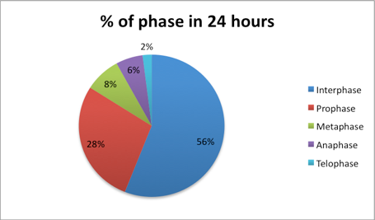
% of time in each phase

Slide 10
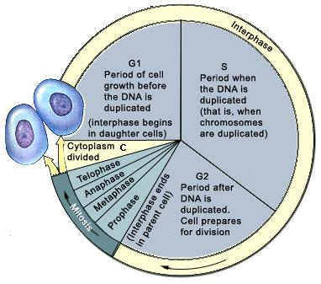
P. 30R- Cell Cycle
Video – 6:11
Cell cycle rap – 3:50
Cell cycle rap 2 – 2:19
http://www.youtube.com/watch?v=I5uFuvkN97I

Slide 11
Cell Cycle Drawing Analysis
What is the longest phase of the cell cycle?
What 2 main things happen during this phase?
What steps involve the nucleus dividing?
What step involves the cytoplasm dividing?
Do bacteria cells undergo mitosis? Explain.
How do bacteria reproduce?
INTERPHASE
GROWTH & DNA REPLICATION
MITOSIS
CYTOKINESIS
NO, THEY DON’T HAVE A NUCLEUS
BINARY FISSION
Video – 1:03

Slide 12
Name that Phase!
I will show you pictures and you have to tell me which phase it shows and what is happening.
You can use your foldable.

Slide 13
Steps of Cell Division – Asexual Reproduction & Mitosis
Interphase - before DNA replicates
DNA appears as chromatin
Centriole
Nucleus
Chromatin
Interphase – after DNA replicates. Also other organelles copy.
Centrioles
Spindle fibers
Nucleus
Chromosomes
Prophase
Chromatin becomes chromosomes
Nuclear envelope breaks down
Centrioles separate and spindle fibers form between them.

Slide 14
Steps of Cell Division – Asexual Reproduction & Mitosis
Centrioles
Spindle fibers
Centromere
Chromosomes
Metaphase
Chromosomes line up along the middle or equator of the cell
Centrioles
Spindle fibers
Centromere
Chromosomes
Anaphase
The sister chromatids move toward opposite poles.

Slide 15
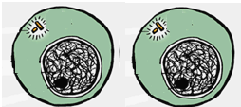
Steps of Cell Division – Asexual Reproduction & Mitosis
Telophase
Spindle fibers break down (disappear)
Chromosomes uncoil into chromatin
Two nuclear envelopes form around chromatin
Centrioles Nucleus Chromosomes
Chromatin
Cytokinesis
Cytoplasm divides forming two identical cells.

Slide 16
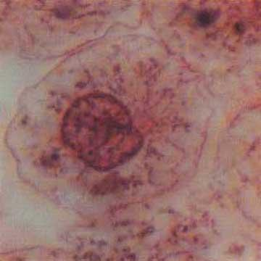
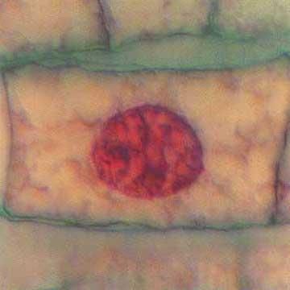
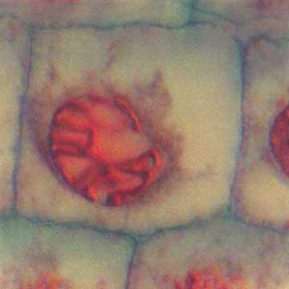
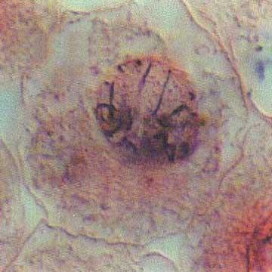
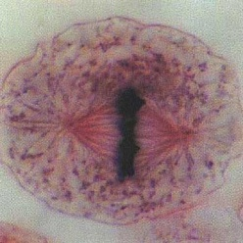
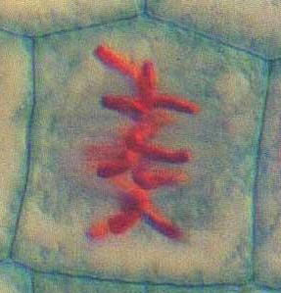
Animal vs. Plant
Interphase
Prophase
Metaphase

Slide 17
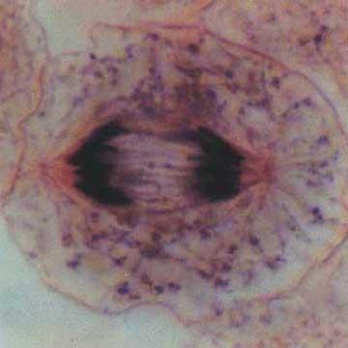
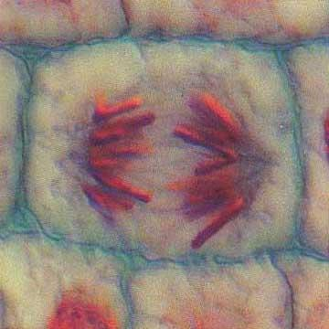
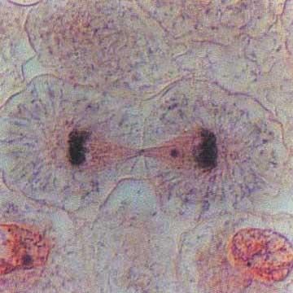
Animal vs. Plant
Anaphase
Telophase/ Cytokinesis

Slide 18
Goal of Mitosis vs. Meiosis
The goal of mitosis is to create _____________ cells with the __________ number of chromosomes to help with growth and healing.
The goal of meiosis is to create the _______ cells with _____the number of chromosomes.
BODY
SAME
SEX
HALF

Slide 19
Terms to Know
TERM | DEFINITION | PICTURE/EXAMPLE
 | Any body cell except the sex cells. These cells have two sets of chromosomes.
 | A sex cell that has half of the chromosomes.
 | Cells with two full sets of chromosomes.
 | Cells with one set of chromosomes.
SKIN, HAIR, MUSCLE, NERVE CELLS
SOMATIC CELL
GAMETE
EGG & SPERM
DIPLOID
SOMATIC (BODY) CELLS
GAMETES (SEX CELLS)
HAPLOID

Slide 20
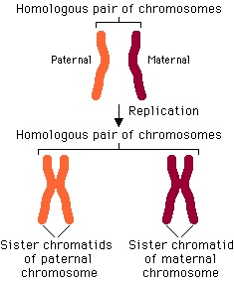
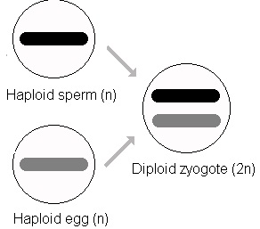
Terms to Know
TERM | DEFINITION | PICTURE/EXAMPLE
 | Chromosomes that are similar in size, shape and genetic info. You have 23 homologous pairs of chromosomes. One of the chromosomes within the pair came from your mom and the other came from your dad.
 | Joining of egg and sperm to form a (fertilized egg).
HOMOLOGOUS CHROMOSOMES
ZYGOTE
FERTILIZATION

Slide 21
Advantages of Sexual Reproduction
An advantage of meiosis coupled with sexual reproduction is the genetic diversity that is the result of:
of an egg and sperm.
(random organization of chromosome pairs at the equator).
occurs during meiosis I in which homologous chromosomes exchange pieces of chromosomes.
RANDOM FERTILIZATION
INDEPENDENT ASSORTMENT
CROSSING OVER

Slide 22
Comparison Chart
Description | MITOSIS | MEIOSIS
In what cells do these processes occur | Somatic (body) cells | Gametes (sex cells)
2. Involved in sexual or asexual reproduction? | asexual | sexual
3. How many times does the nucleus divide? | once | twice
4. At the end, how does the daughter cell compare to the parent? | identical | half the number of chromosomes
5. Diploid or haploid at the beginning of the process? | diploid | diploid
6. Diploid or haploid at the end of the process? | diploid | haploid

Slide 23
Comparison Chart
Description | MITOSIS | MEIOSIS
7. Does the process increase genetic variation? | no | yes
8. How many cells are produced in the end? | 2 | 4
9. Describe a human cell that would be produced by this process | contains 46 chromosomes | contains 23 chromosomes
10. Advantages | allows new cells to have exact copies of the DNA | allows for genetic variation
11. Disadvantages | No genetic variation | Easier for mistakes to occur

Slide 24
Chromosomal Mutations
piece of a chromosome breaks off Ex: Cri du Chat syndrome (“cry of the cat”) infants have a distinctive cry, severe mental retardation and short life span.
chromosome fragment attaches to homologous chromosome which will no have 2 copies of certain genes Ex: Certain types of cancer
DELETION
DUPLICATION DELETION

Slide 25
Chromosomal Mutations
INVERSION
chromosome piece reattaches to original chromosome but in reverse orientation Ex: Hemophilia (blood clotting disorder)
chromosome piece attaches itself to a nonhomologous chromosome Ex: Leukemia
TRANSLOCATION

Slide 26
Chromosomes determine your sex
You have 23 pairs or 46 chromosomes
_____________ – are pairs 1-22. These do not determine your sex. They determine other characteristics such as eye color.
______________________ – the 23rd pair of chromosomes. This pair determines your sex.
Female – _______ Male _____ (this is true for humans but varies in other organisms)
AUTOSOMES
SEX CHROMOSOMES
XX
XY

Slide 27
How can someone get too many or too few chromosomes?
humans missing 1 of 46 chromosomes ------- die
Exception:
humans with 3 copies of one chromosome ------
_____________________ – picture of the chromosomes in a cell that is used to check for abnormalities
XO SYNDROME – FEMALE WITH ONLY ONE X CHROMOSOME
TRISOMY
KARYOTYPE

Slide 28
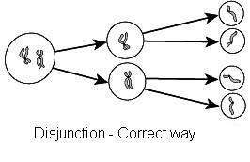
DISJUNCTION
If meiosis occurs correctly this is called:
– proper separation of chromosomes during meiosis
DISJUNCTION

Slide 29
NONDISJUNCTION
How does a person get an extra chromosome? This is when meiosis does not occur correctly.
– failure of chromosomes to separate during meiosis resulting in too many or too few chromosomes in the gametes
NONDISJUNCTION

Slide 30
Karyotype 1
1-22 pairs - autosomes
23rd pair – sex chromosomes. This is a male XY

Slide 31
Karyotype 2
Trisomy 21 – Down’s syndrome.
Female - XX

