Slide 1
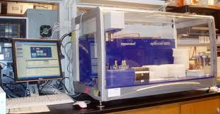
Technologies have changed the way humans influence the inheritance of desired traits in organisms.
Selective Breeding / Artificial Selection
Gene Therapy
Genetic Modification
Copyright © 2010 Ryan P. Murphy

Slide 2
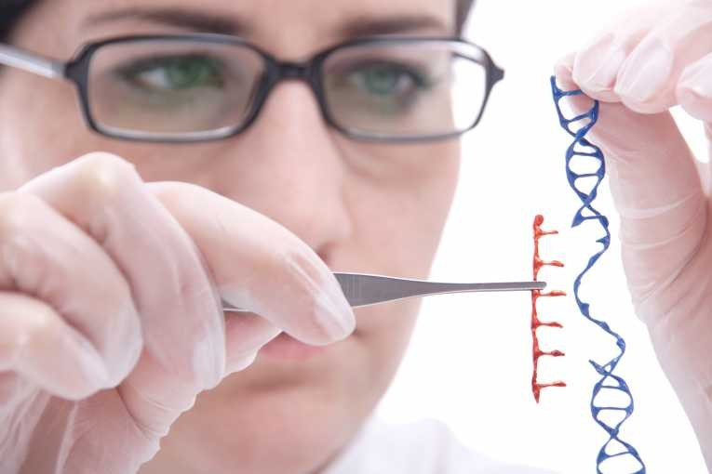
Genetic engineering refers to a set of technologies that are being used to change the genetic makeup of cells.
By moving genes across species boundaries you can produce novel organisms.
Copyright © 2010 Ryan P. Murphy

Slide 3
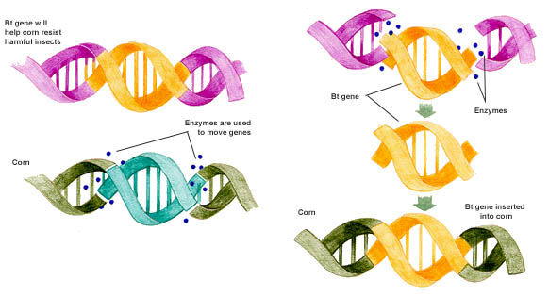

Slide 8
This corn will now
be more resistant
to harmful insects

Slide 9
This corn will now
be more resistant
to harmful insects

Slide 10
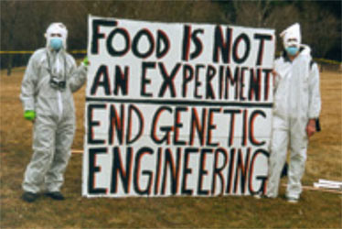
This technology has
created quite a stir…

Slide 11
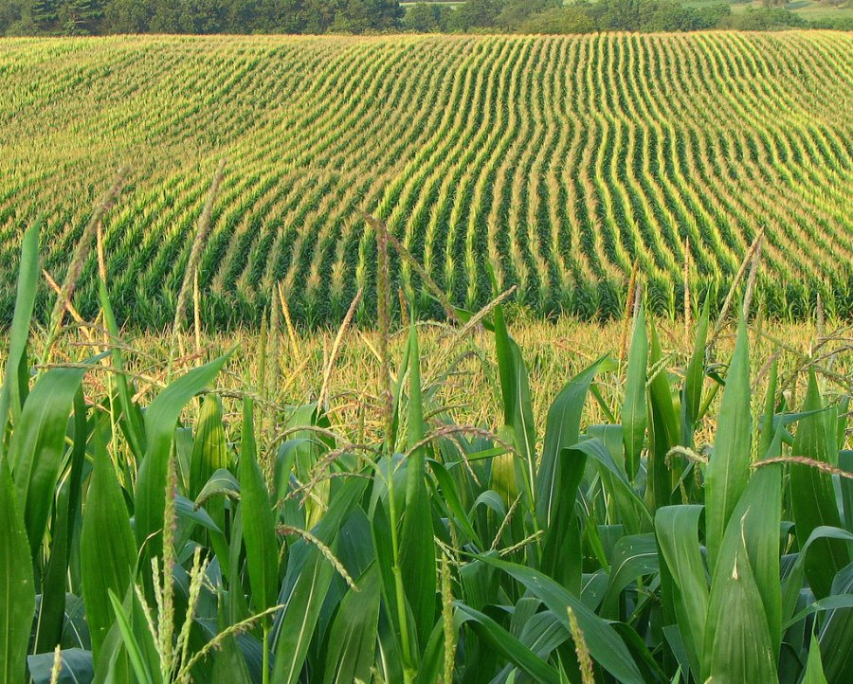
Another heated GMO debate is over genetically modified seeds in monoculture.
The cultivation of a single crop in a given area
Copyright © 2010 Ryan P. Murphy

Slide 12
Another heated GMO debate is over genetically modified seeds in monoculture.
Some argue that if every seed planted is exactly the same genetically, the risk of a widespread disease wiping out everything is increased.
Copyright © 2010 Ryan P. Murphy

Slide 13
Another heated GMO debate is over genetically modified seeds in monoculture.
Some argue that if every seed planted is exactly the same genetically, the risk of a widespread disease wiping out everything is increased.
Viruses?
Parasites?
Fungi?
Insects?
Bacteria?
Copyright © 2010 Ryan P. Murphy

Slide 14
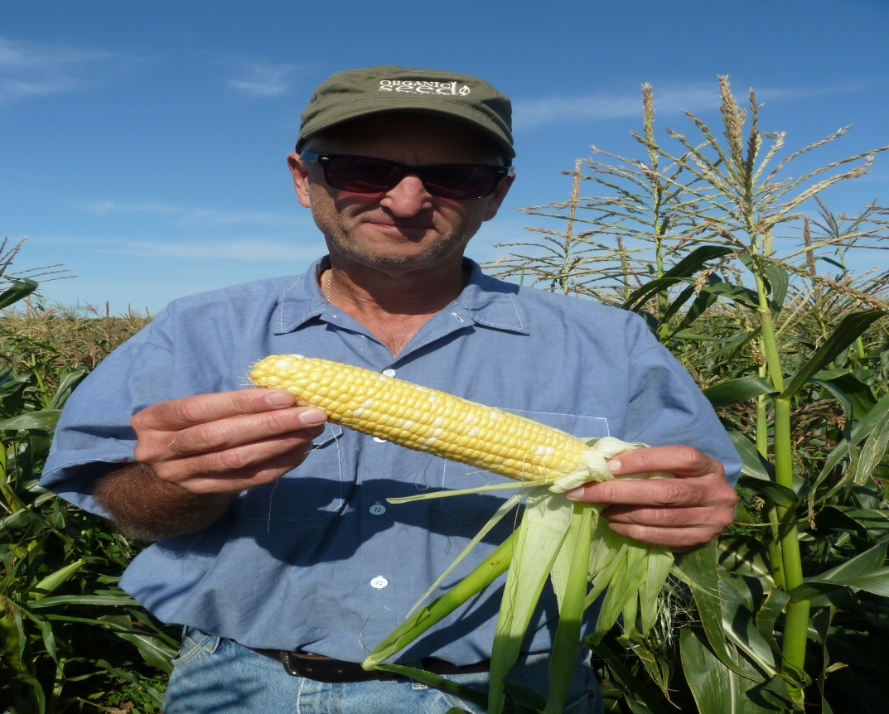
Another heated GMO debate is over genetically modified seeds in monoculture.
Some argue that if every seed planted is exactly the same genetically, the risk of a widespread disease wiping out everything is increased.
Many scientists feel that having genetic diversity with many types of crops (genetic variation) is likely to reduce the odds of massive crop failure.
Copyright © 2010 Ryan P. Murphy

Slide 15
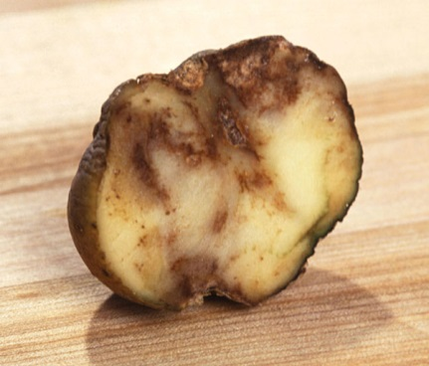
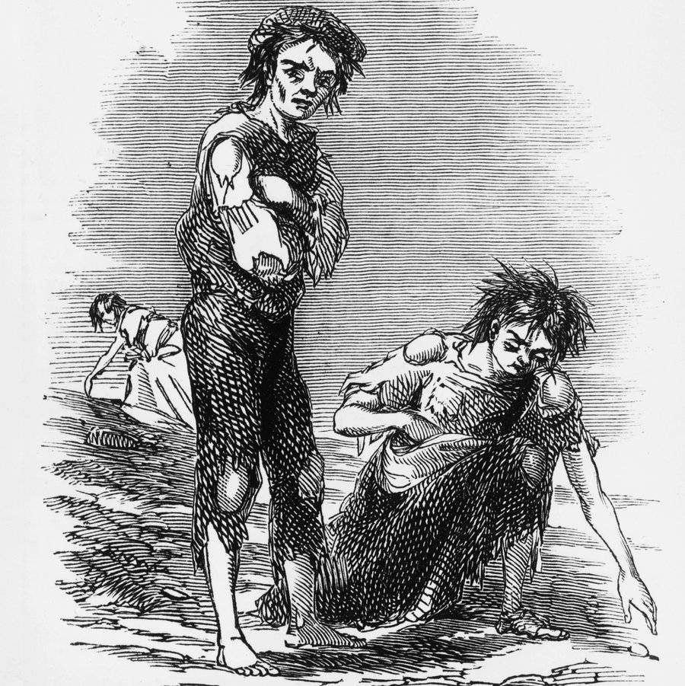
Another heated GMO debate is over genetically modified seeds in monoculture.
Some argue that if every seed planted is exactly the same genetically, the risk of a widespread disease wiping out everything is increased.
The lack of genetic variation in Irish potatoes contributed to the severity of the Irish potato famine (1740), which devastated Ireland's population and economy.
Copyright © 2010 Ryan P. Murphy

Slide 16
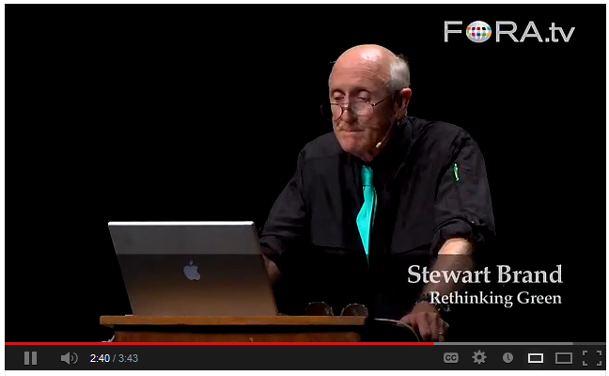
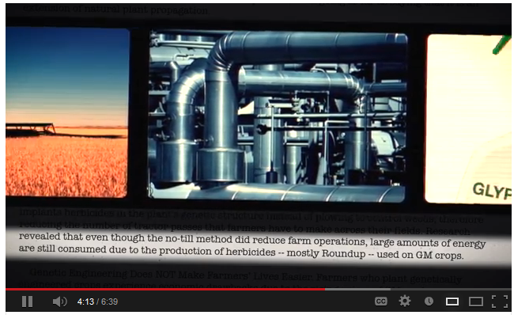
Video Links!
Against GMO and for GMO’s
Genetically Modified Organisms.
Copyright © 2010 Ryan P. Murphy

Slide 17
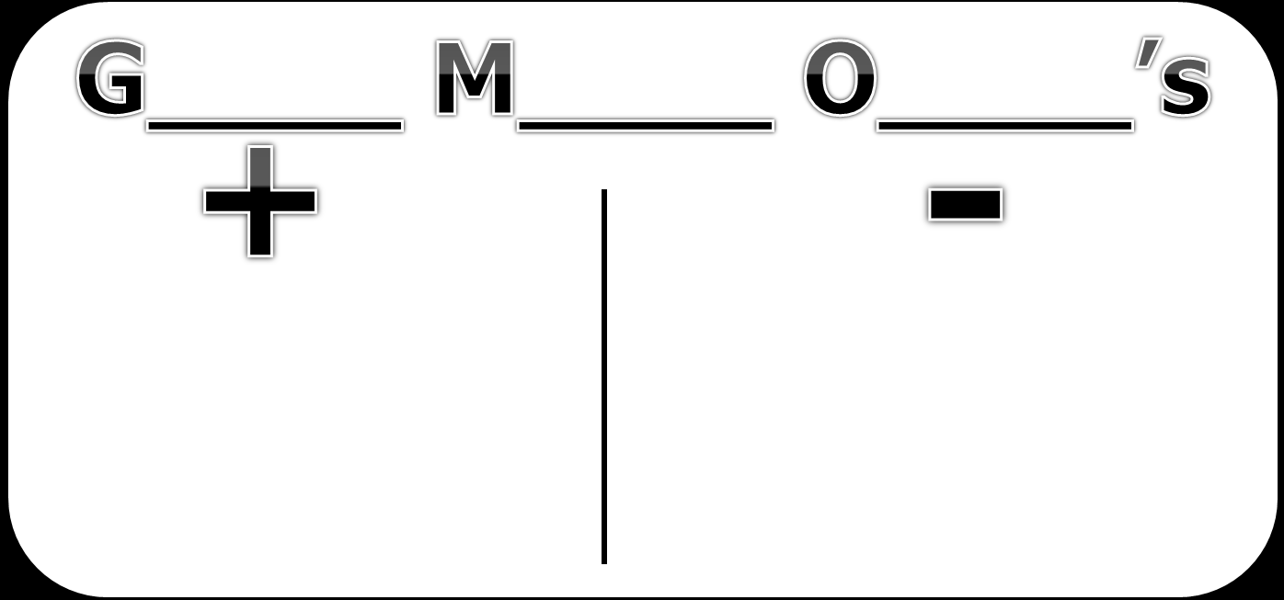
Video Links!
Against GMO and for GMO’s
Genetically Modified Organisms.
For GMO’s
Against GMO’s
https://www.youtube.com/watch?v=v-vYXzXxN70
https://www.youtube.com/watch?v=M_ztZGbLEJ0&noredirect=1
Copyright © 2010 Ryan P. Murphy

Slide 18
After watching the videos on the previous slide, read the article in the link below and make a chart showing the pros and cons of GMOs (like the one on the next slide).
Based on the information you have, what is your opinion of GMOs? (1-2 paragraphs)
If you finish early (or if you are interested), watch the TED talk in the video linked at the bottom.
Article →
https://www.wisegeek.com/what-are-the-pros-and-cons-of-genetically-engineered-food.htm
TED Talk (one perspective) →
https://www.ted.com/talks/pamela_ronald_the_case_for_engineering_our_food?language=en#t-871611

Slide 19
G____ M____ O____’s
-
+

