Slide 3
New Area of Focus: Bio-Ethics
Copyright © 2010 Ryan P. Murphy

Slide 4
Bio-Ethics: The study of ethical issues raised by the developments in life science technologies.
Copyright © 2010 Ryan P. Murphy

Slide 5
There are many topics that could be covered within the study of bio-ethics. A few include…
Embryonic Stem Cells
Cloning
Organ transplants.
Pandemic Planning.
Medical Research.
Health Systems and Care.
Creation of synthetic life
Copyright © 2010 Ryan P. Murphy

Slide 6
Ethics - The study of values - good and bad, right and wrong.
Copyright © 2010 Ryan P. Murphy

Slide 7
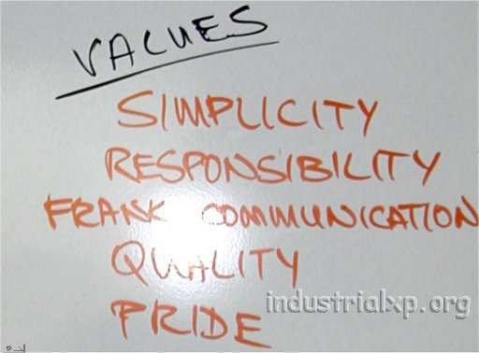
Values: The beliefs of a person.
Copyright © 2010 Ryan P. Murphy

Slide 8
Beliefs - Mental acceptance of and conviction in the truth, actuality, or validity of something.

Slide 9
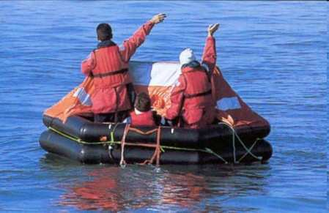
Discussion Board Activity - Sinking Ship: An Ethical Dilemma.
Copyright © 2010 Ryan P. Murphy

Slide 10
Sinking Ship, An Ethical Dilemma.
A ship is sinking in the middle of the ocean, help will not arrive on time. The life raft can only support eight people. Who should be allowed on the raft?
Copyright © 2010 Ryan P. Murphy

Slide 11
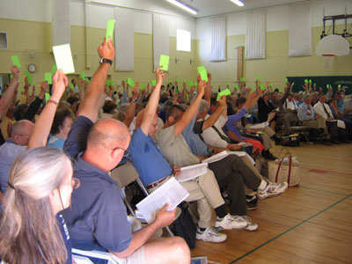
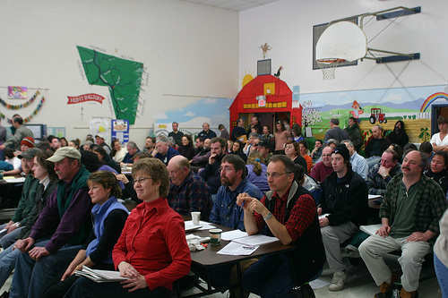
Discussion board activity: decide which eight people you want to put on the raft. Write 1 paragraph for each question:
Explain why you chose those 8 people.
What values influenced your decision?
Discuss whether or not there is any choice that could be considered ethical. Why or why not?

Slide 12
#1) 28 year old Woman who thinks she is six weeks pregnant.
#2) 50 year old Marine with survival skills.
#3) Recently married couple (third marriage) ages 44 and 56.
#4) Senior citizen who worked for 50 years in a charitable organization.
#5) 40 year old Kindergarten teacher who helps the disabled.
#6) 13 year old girl with serious behavioral challenges such as bullying.
#7) 22 year old man who runs a homeless shelter.
#8) 65 year old Doctor who claims to have the cure for cancer.
#9) 35 year old male popstar with ideas for new hit single.
#10) 29 year female, Catholic nun does missionary work in Africa.
#11) 24 year old released convict who did time for using drugs
#12) 65 year old pharmaceutical executive worth billions.
#13) 12 year old boy with down syndrome
#14) 29 year old female house keeper who is an illegal immigrant
#15) 9 year old son of the illegal immigrant housekeeper
#16) U.S. Senator age 65 with 30 years of service to the country

Slide 13
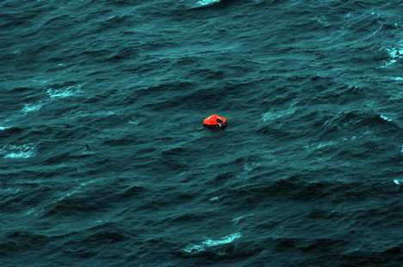
The correct answer…
There’s no correct answer. We can only learn about our own values from this exercise.
I hope that I would never have to deal out death and judgment.
What did we value?

