Slide 1
PHOTOSYNTHESIS
Absorbing Light Energy to make chemical energy: glucose!
Pigments: Absorb different colors of white light (ROY G BIV)
Main pigment: Chlorophyll a
Accessory pigments: Chlorophyll b and Carotenoids
These pigments absorb all wavelengths (light) BUT green!

Slide 2
The photograph below is an elodea leaf X 400. Individual cells are clearly visible. The tiny green structures within the cells are chloroplasts.
This is where photosynthesis takes place. This is where the a plant’s pigments are predominantly located.

Slide 3
PHOTOSYNTHESIS
2 Phases
Light-dependent reaction
Light-independent reaction
Light-dependent: converts light energy into chemical energy; produces ATP molecules to be used to fuel light-independent reaction
Light-independent: uses ATP produced to make simple sugars.

Slide 4
PHOTOSYNTHESIS
Light-dependent reaction (LIGHT Reaction)
Requires light
Occurs in chloroplast (in thylakoids)
Chlorophyll (thylakoid) traps energy from light
Light excites electron (e-)
Kicks e- out of chlorophyll to an electron transport chain
Electron transport chain: series of proteins in thylakoid membrane
Bucket brigade

Slide 5
PHOTOSYNTHESIS
Light-dependent reaction (LIGHT Reaction)
Energy lost along electron transport chain
Lost energy used to recharge ATP from ADP
NADPH produced from e- transport chain
Stores energy until transfer to stroma
Plays important role in light-independent reaction
Total by-products: ATP, NADP, O₂

Slide 6
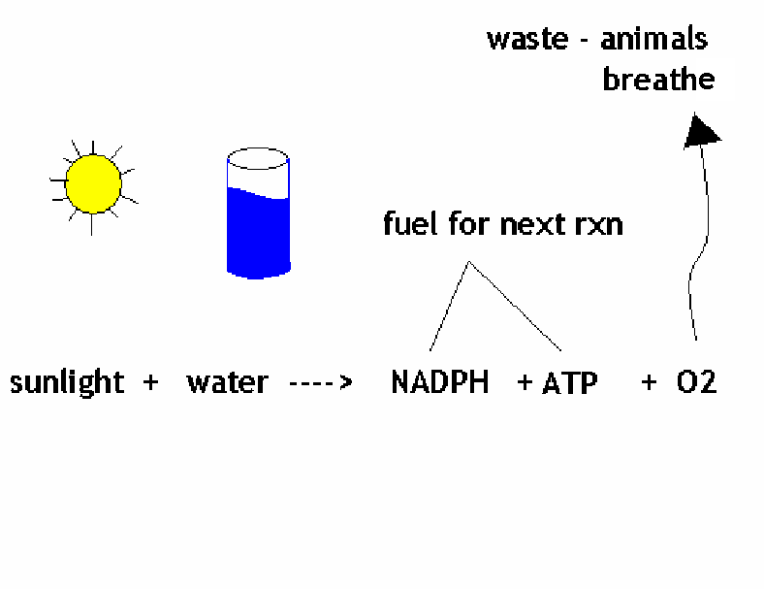
PHOTOSYNTHESIS
How did we get O₂ as a byproduct?!
Photolysis: replaces lost electrons by splitting water

Slide 7
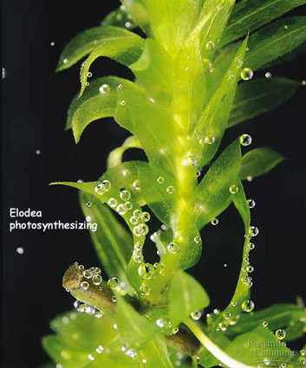

Slide 8
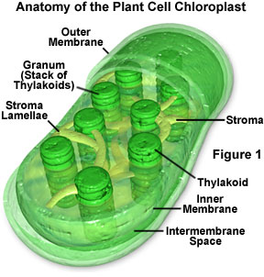
PHOTOSYNTHESIS
Why do we see green?
Green color from white light reflected NOT absorbed
Chloroplast: organelle responsible for photosynthesis
Chlorophyll: located within Chloroplast
Green pigment

Slide 9
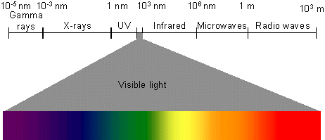
Visible light is only a small part of the electromagnetic spectrum (all forms of light).

Slide 10
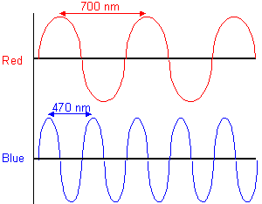
LIGHT behaves as if it were composed of "units" or "packets" of energy that travel in waves. These packets are photons.
The wavelength of light determines its color, or classification of a non-visible electromagnetic energy

Slide 11
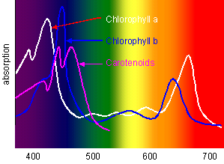

Slide 12
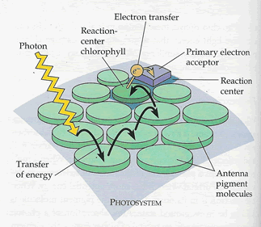
Photosystems

Slide 13
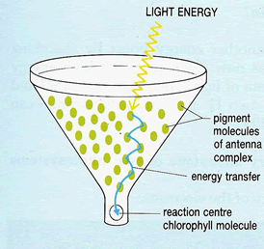
Photosystems

Slide 14
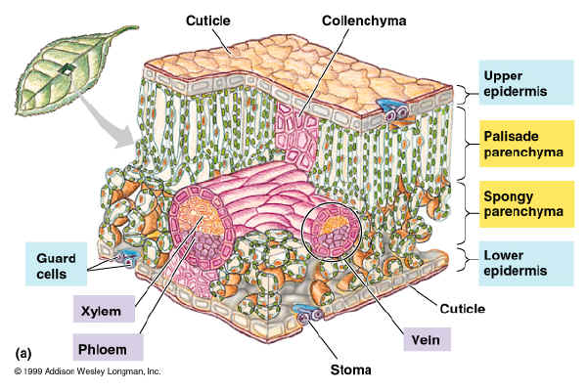
Plant leaves have many types of cells!

Slide 15
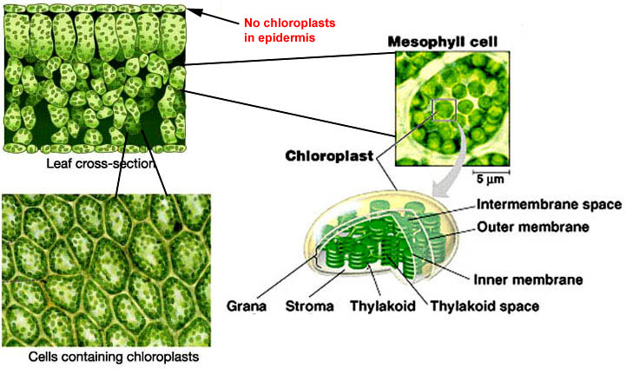
Plant Cells

Slide 16
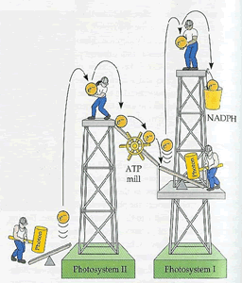
Electron Transfer

Slide 17
Electron Transfer
Remember that the light energy was collected in order to excite electrons (e-).
These excited electrons are then transferred by specific proteins to serve as the fuel for subsequent reactions.
In Summation:
The light-dependent reactions use solar power to generate ATP and NADPH which provide chemical energy and reducing power to the sugar making reactions.

Slide 18
Thank you for your attention and participation!
This powerpoint was painstakingly plagiarized and rearranged from numerous cannibalized internet files by Mr. Sonnenberg.
(Although the actual editing did involve some significant thought and effort.)

